Slide 1

Data link control and Protocols

Slide 2
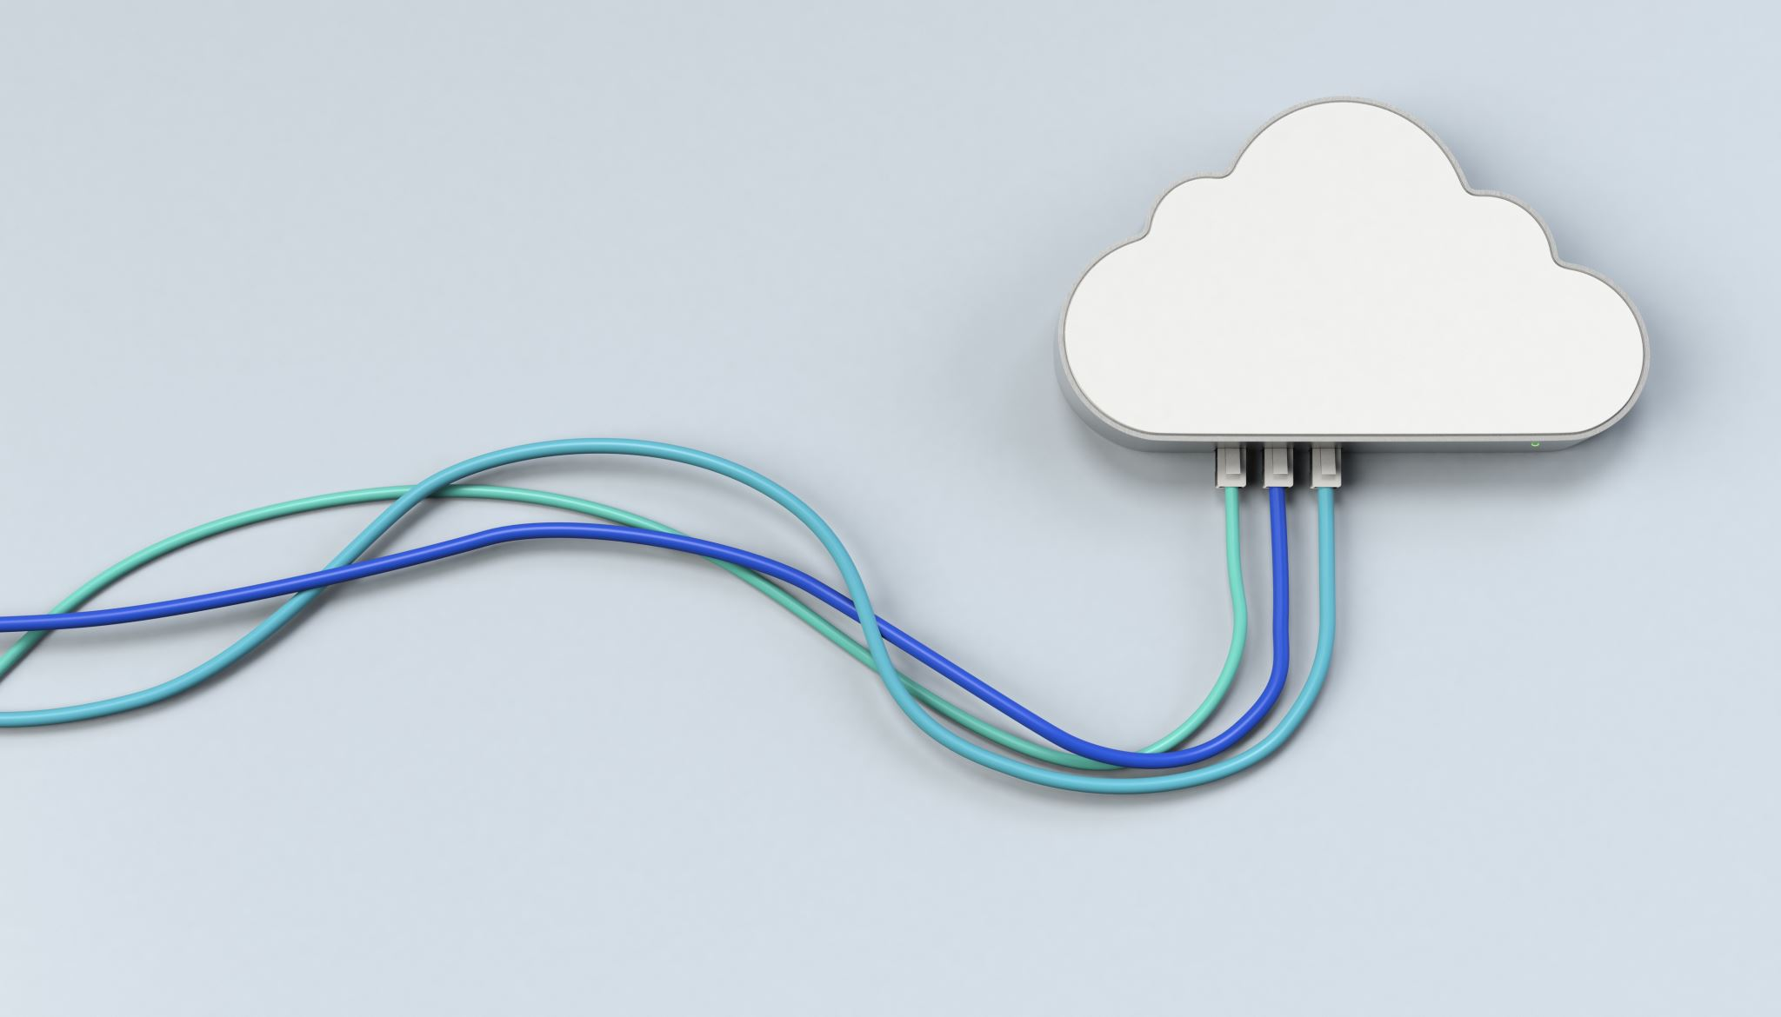
Flow Control:
When a data frame (Layer-2 data) is sent from one host to another over a single medium, it is required that the sender and receiver should work at the same speed.
That is, sender sends at a speed on which the receiver can process and accept the data.
What if the speed (hardware/software) of the sender or receiver differs? If sender is sending too fast the receiver may be overloaded, (swamped) and data may be lost.
Two types of mechanisms can be deployed to control the flow:
Stop and wait
Sliding Window

Slide 3
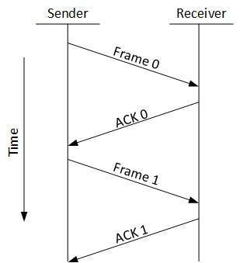
Stop and Wait:
This flow control mechanism forces the sender after transmitting a data frame to stop and wait until the acknowledgement of the data-frame sent is received.

Slide 4
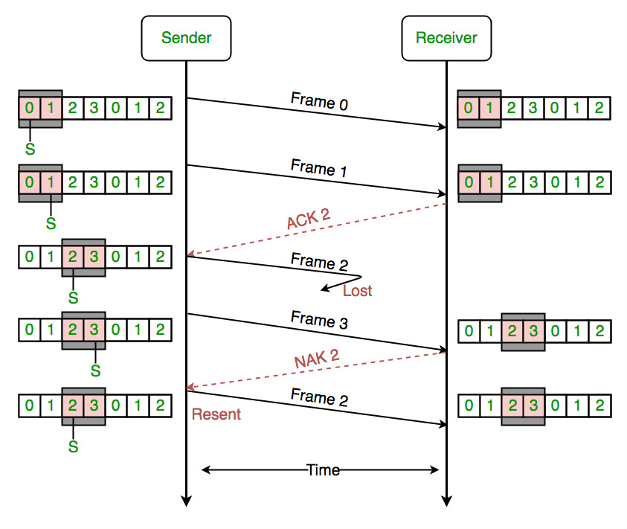
Sliding Window
In this flow control mechanism, both sender and receiver agree on the number of data-frames after which the acknowledgement should be sent.
As we learnt, stop and wait flow control mechanism wastes resources, this protocol tries to make use of underlying resources as much as possible.

Slide 5

Error Control
When a data frame is transmitted, there is a chance that it will either be corrupted or lost in route.
In both situations, the sender is unaware of any loss and the receiver is not given the correct data frame.
In this situation, both the transmitter and the receiver are outfitted with protocols that enable them to recognize transit faults such data-frame loss.
As a result, either the sender or the recipient may ask for the preceding data frame to be sent again.

Slide 6
Error Mechanism
Error detection - Both the sender and the recipient, or just one of them, must confirm that there was a transit error.
Positive ACK - The receiver should acknowledge each correct frame it receives.
Negative ACK - The sender must retransmit the proper frame if the receiver gets a broken or duplicate frame by returning a NACK to the sender.
Retransmission: The sender keeps a clock and establishes a timeout duration. The sender retransmits the data frame in the event that the acknowledgement of a previously sent data frame does not arrive within the timeout, believing that the frame or its acknowledgement was lost in route.

Slide 7
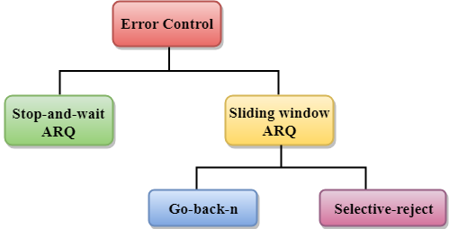
Error Control Techniques
There are three types of techniques available which Data-link layer may deploy to control the errors by Automatic Repeat Requests (ARQ):

Slide 8
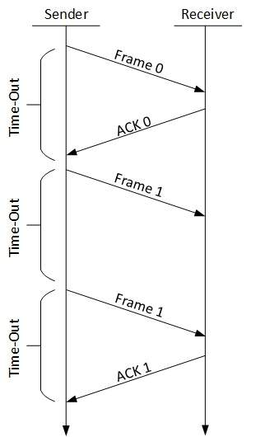
Stop-and-wait ARQ
The following transition may occur in Stop-and-Wait ARQ:
The sender maintains a timeout counter.
When a frame is sent, the sender starts the timeout counter.
If acknowledgement of frame comes in time, the sender transmits the next frame in queue.
If acknowledgement does not come in time, the sender assumes that either the frame or its acknowledgement is lost in transit. Sender retransmits the frame and starts the timeout counter.
If a negative acknowledgement is received, the sender retransmits the frame.

Slide 9
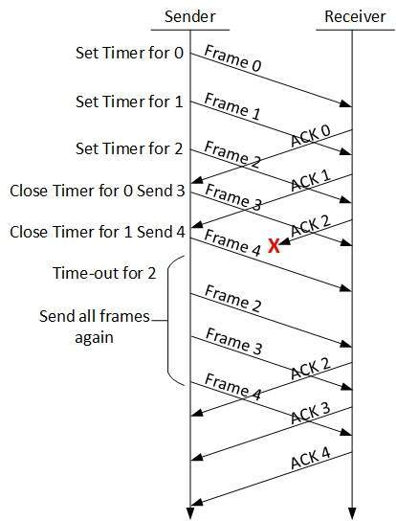
Sliding window
Stop and wait ARQ mechanism does not utilize the resources at their best.
When the acknowledgement is received, the sender sits idle and does nothing.
In Go-Back-N ARQ method, both sender and receiver maintain a window.
The sending-window size enables the sender to send multiple frames without receiving the acknowledgement of the previous ones.
The receiving-window enables the receiver to receive multiple frames and acknowledge them.
The receiver keeps track of incoming frame’s sequence number.

Slide 10
Go-Back-N ARQ
After sending every frame in the window, the sender checks to see what sequence number it has gotten a positive acknowledgement for.
The sender sends the following batch of frames if all of them have been affirmatively acknowledged. Sender retransmits all frames after which it receives no affirmative ACK if it discovers that it has gotten NACK or no ACK for a specific frame.

Slide 11
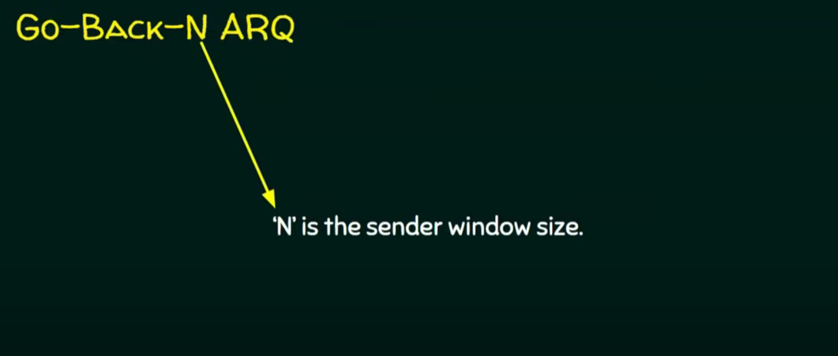
Go-Back-N ARQ

Slide 12
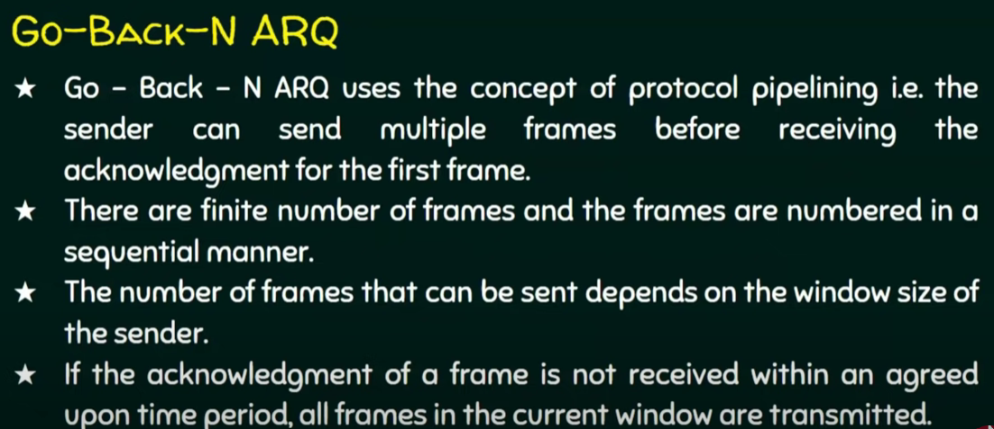

Slide 13
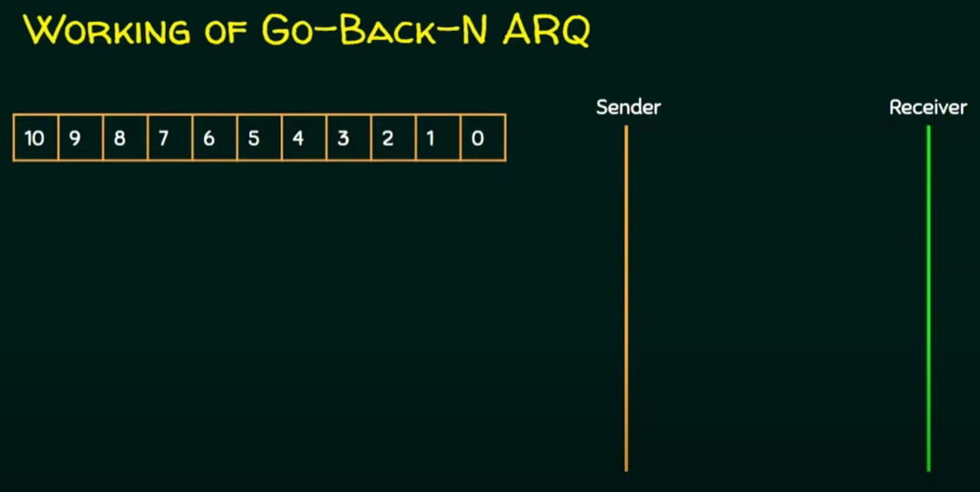

Slide 14
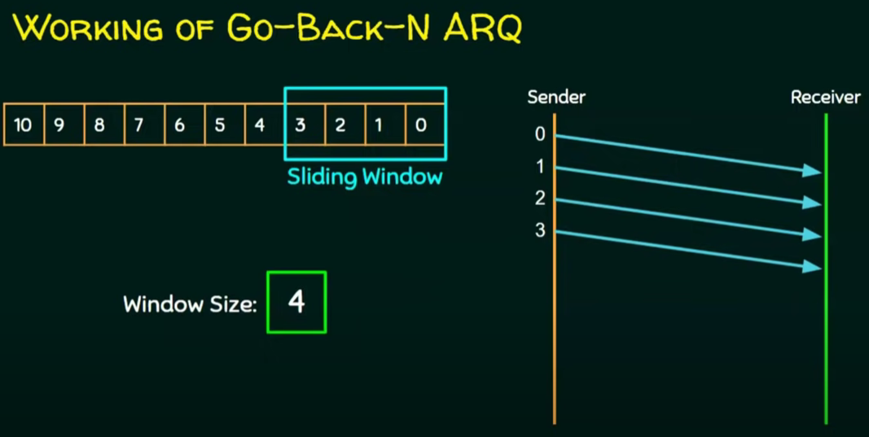

Slide 15
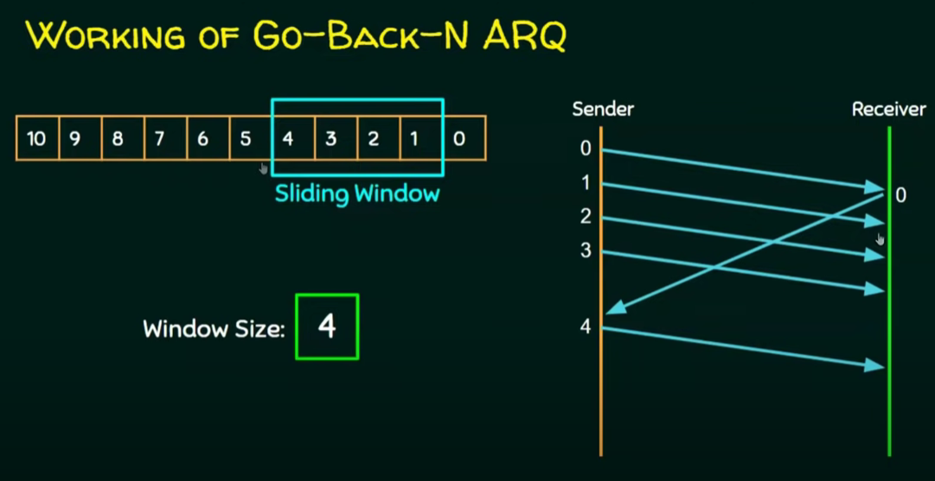

Slide 16
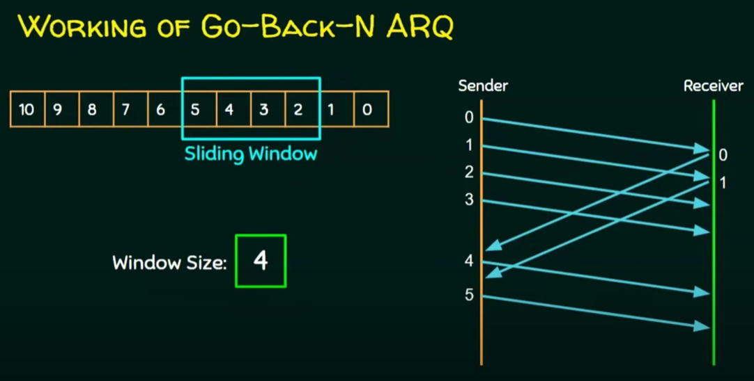

Slide 17
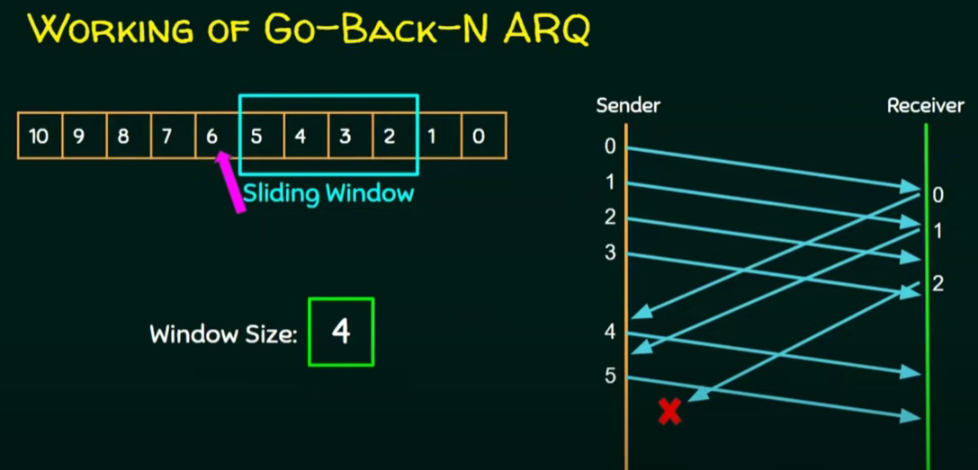

Slide 18
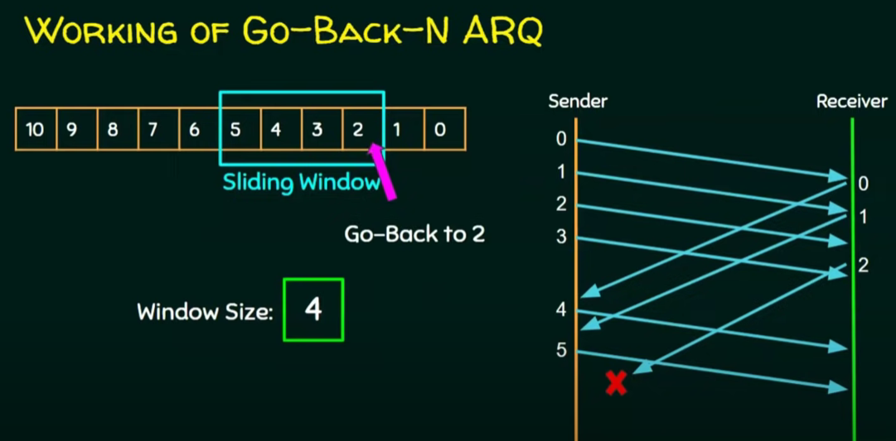

Slide 19
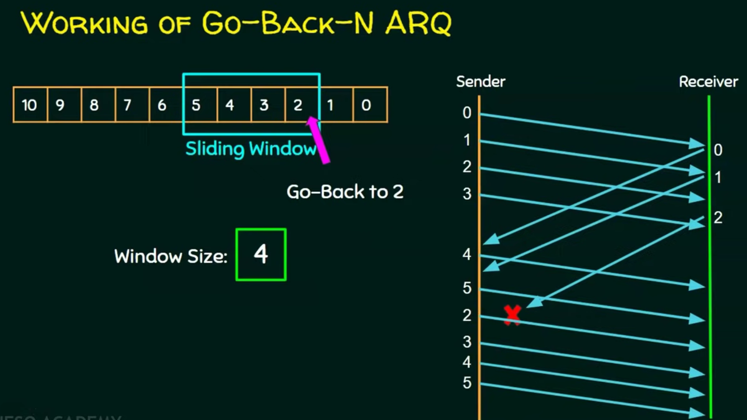

Slide 20
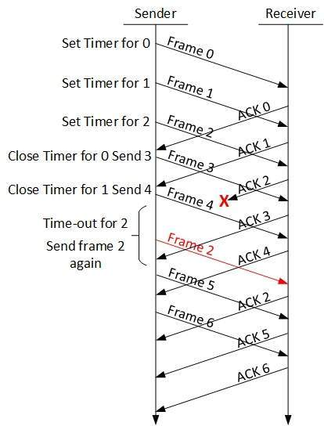
Selective Repeat ARQ
In Go-back-N ARQ, it is expected that the receiver will have to process each frame as it arrives since it will not have enough buffer capacity for its window size.
This requires the sender to send every frame that is not acknowledged again.
In Selective-Repeat ARQ, the receiver buffers the frames in memory while keeping track of the sequence numbers and sends NACK for just the frame that is broken or missing.
In this instance, the sender only delivers packets for which NACK is received.

